Slide 1
TROY GROUP Inc.
TROY Group Products and Features Presentation
Pascal Fichet
pfichet@troygroup.com

Slide 2
TROY Products
Security printers: Printer with secure paper trays
Font cards: MICR, Bar code, OCR and Security fonts
Digitizing : signatures and logo digitizing
TROY toner
TROY MICR toner
TROY Security toner / TROY MICR Secure
TROY indelible solution
TROY UV Toner / TROY MICR UV toner
MICR printer: check printing
Secure DXi printers: Secured printer to secure high value document
Rx/DX: upgrade kit and printers to secure valuable document
Secure UV printer
Secure Jet printer
TSPE: Software to secure valuable document
TSOM
TCWS
CheckFlow
Check Printing adds-on

Slide 3
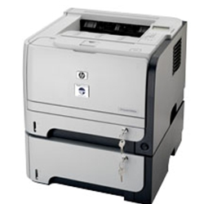
TROY GROUP Inc.
Security Printers

Slide 4
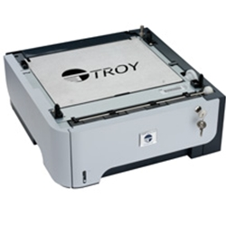
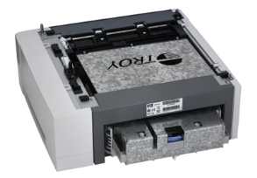
TROY Products – Security printers
Input tray provides security to prevent unauthorized access to high value paper stock.
Notes:
Key locks
Metal plates covers
Locking mechanism between tray and printer

Slide 5
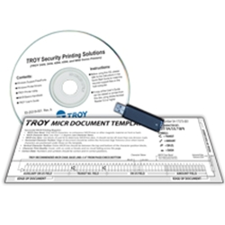
TROY GROUP Inc.
Font cards

Slide 6
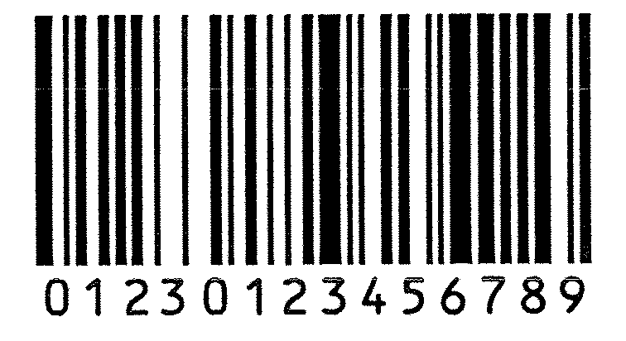
TROY Products – Font card
DIMM, Compact Flash or USB thumb drive housing TROY PCL5e printer resident fonts - Only visible on outputs
Bar code fonts: UPC-A, UPC-E, EAN-8, EAN-13, BC25, BC39, BC128, POSTNET, POSNET reverse
MICR fonts: E-13B, CMC7
MicroPrint font : 0.6 pt font
Security fonts: ECF, LCF, SCF, Security font, International Convenience Amount (FR, SP, UK)
MISC: OCR A, OCR B, TROY Helvetica reverse

Slide 7
TROY GROUP Inc.
Digitizing

Slide 8
TROY Product – Digitizing
Digitizing
From a BMP to a PCL5 printer soft font
DIMM card, compact flash or thumb drive
Comes with the escape sequence, metrics and Windows fonts
a b c d e f
<Esc>(201Q<Esc>(s0p2h72v0s0b201Tabcdef

Slide 9
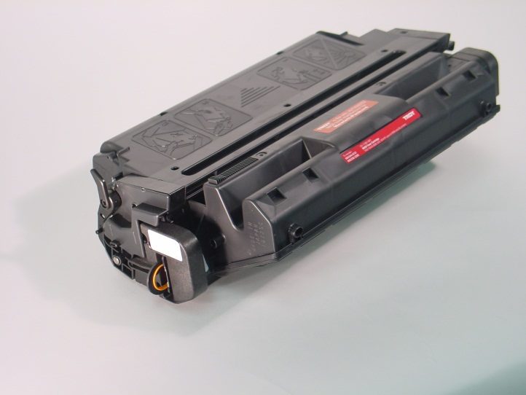
TROY GROUP Inc.
TROY toner and indelible solution

Slide 10
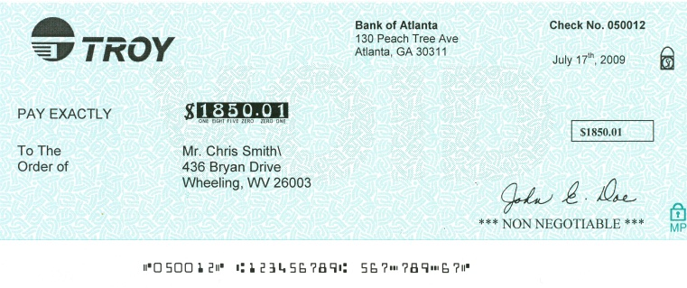
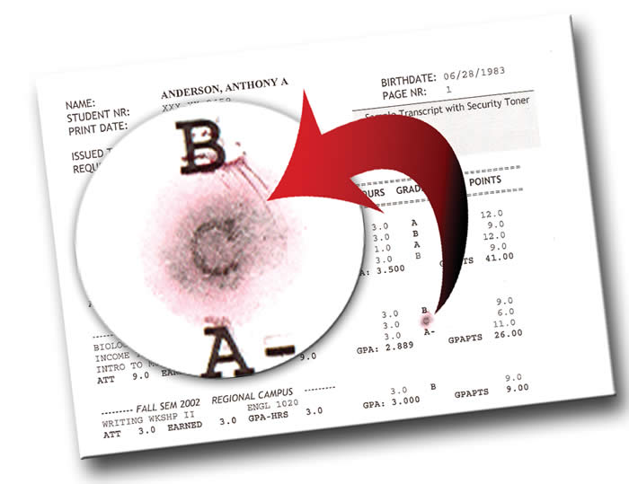
TROY Product – Toner
MICR toner
Check printing
Magnetic or optical toner sensing (with TROY printers)
Works with regular HP printers
We supply some Lexmark, Xerox, IBM printer models with MICR toner
Security toner
Special toner forces a bright red stain to appear if chemical alteration is attempted.
MICR toner secure
MICR toner with Security toner properties (red dye)
Notes:
Is the toner filling the lexmark, ibm…a troy toner?
How to call the magnet we glue / white sticker : sensor xxxx?

Slide 11
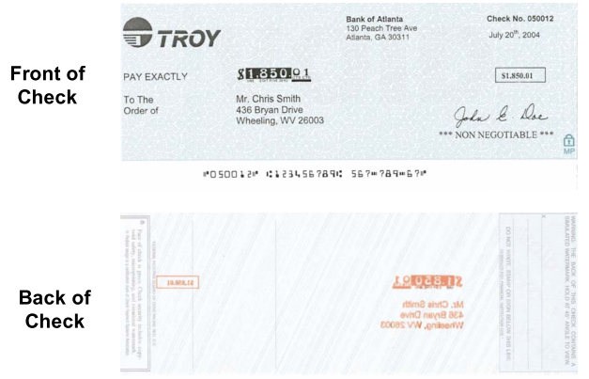
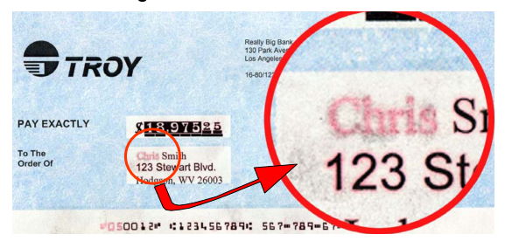
TROY Product - Indelible Solution
Indelible solution
Coating with migration agent to apply on selective areas to secure
To use WITH TROY Security toner or TROY MICR secure toner for the red dye agent benefit.
Red bleeding goes through the paper thickness to be visible on the back side of the document. Visible on the front if toner is removed.

Slide 12
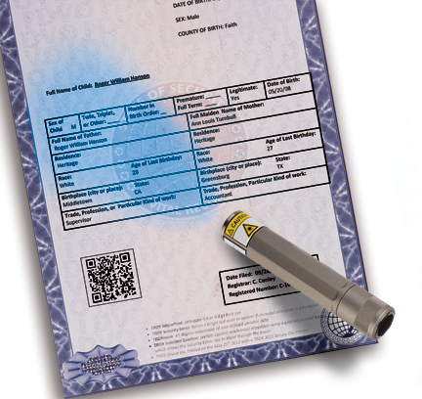
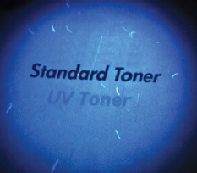
TROY Product – UV toner
UV toner
Prints black, fluoresce blue under UV light
UV MICR toner
Prints black, fluoresce blue under UV light
MICR printing

Slide 13
TROY Printers
PCL5e only
Displays “TROY model Ready”
Modifies default HP settings
Access to TROY settings
Printer control panel
TROY printer Utility
HP Printer
+ paper tray locks
Incoming data stream
Printer key lock
TROY I/O filter firmware
Toner
cartridge Sensor
HP printer engine
Notes:
All troy hardware firmware will change the ready message to TROY xxx ready
Modifies default HP settings :
Toner density
Jam recovery
Toner low notification (from warning to stop)
Can use regular HP toner

Slide 14
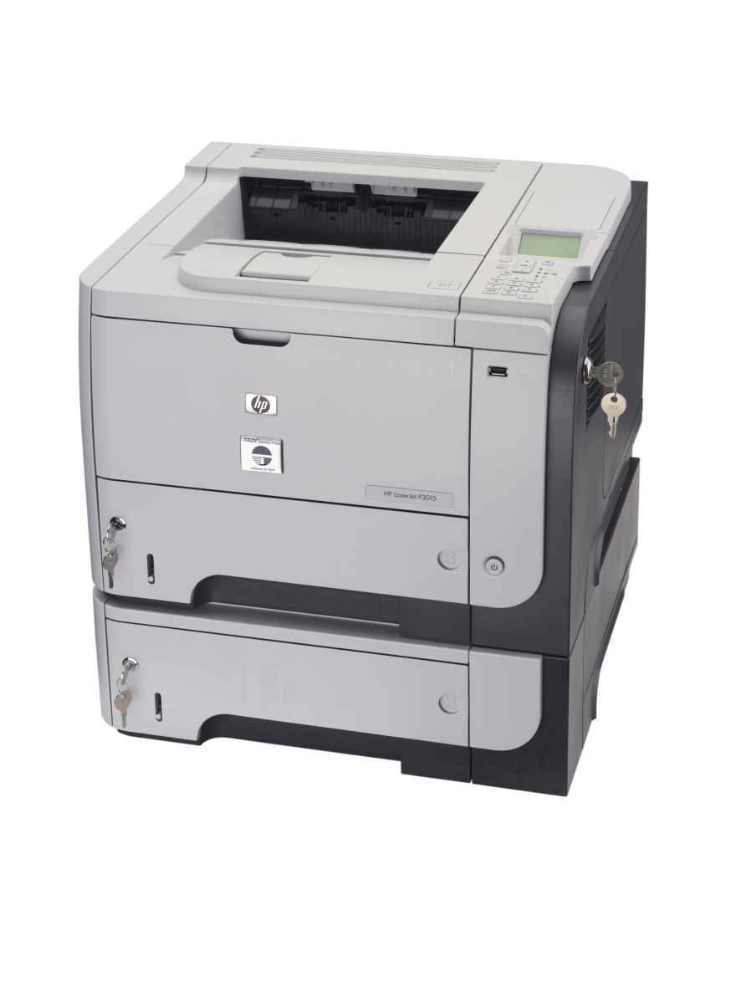
TROY GROUP Inc.
MICR Printers

Slide 15
TROY – MICR Printers – MICR Fonts
MICR hardware fonts
E-13B (USA – Canada – UK,…)
CMC7 (Spain, France,…)
Security fonts

Slide 16
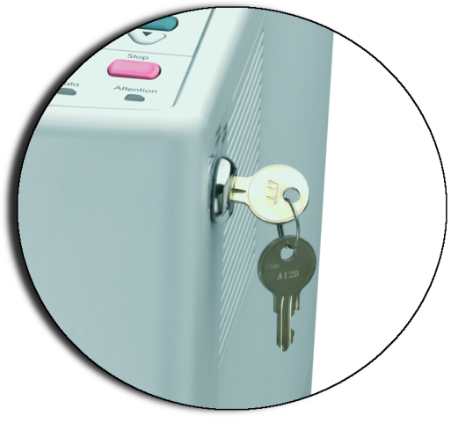
TROY – MICR printers – Printer key lock
3 position printer key lock
Print MICR
Job is recognized as MICR job if it includes a call to a TROY MICR font
Toner sensing : printer checks if a TROY MICR toner cartridge is loaded
Printer Locked
No job can be printed
MICR Locked
Regular jobs allowed but MICR jobs

Slide 17
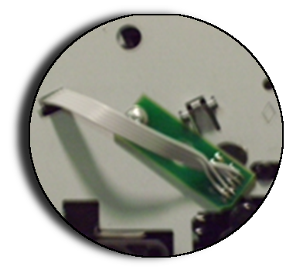
TROY – MICR Printers – MICR toner sensing
MICR toner sensing
Purpose is to avoid any check printing with regular toner (causing rejection and fees)
On a MICR Job (TROY MICR font called) the printer uses the toner sensor to check if a TROY MICR toner cartridge is loaded
If non TROY cartridge loaded, printer prompts to load TROY MICR toner cartridge or to cancel job

Slide 18
TROY – MICR Printers – TROYmark
45 degree watermark
Static text and/or captured text from data stream; printing repetitive instances of document info to deter counterfeiting.
Pre-defined and customizable patterns (light, medium, dark, + 3 custom)
Exclusion areas
Any area, front or back side of the page

Slide 19
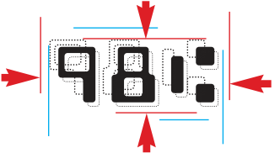
TROY – MICR Printers – Other features
Printer PIN codes
Encryption / decryption
User profiles
Audit report
ExptOffset
Secure flash memory for fonts and macro storage
Tray mapping
HP settings
Disabled jam recovery
Toner density to 3
Copies to 1

Slide 20
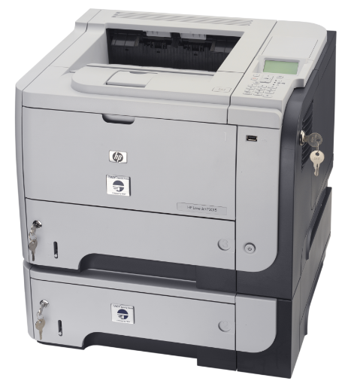
TROY GROUP Inc.
Secure DXi Printers

Slide 21
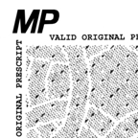
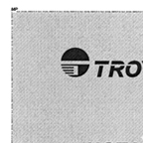
TROY – DXi Printers – Pantograph
Pantograh / Micro Print border / Warning box
MicroPrint border
0.6 pt text surrounding an definite area
Cannot be readable after copy
Pantograph
Background with an interference pattern hiding words. Words are more visible on copy.
Warning Box
Customizable text box printed right below a pantograph area

Slide 22
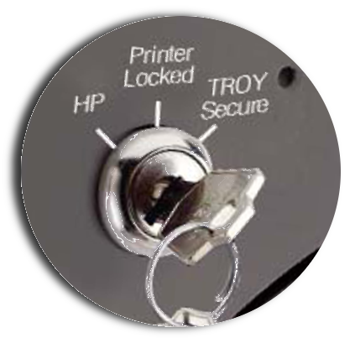
TROY – Secure DXi printers – Printer key lock
Secure DXi printer : 3 position printer key lock
TROY Secure
All jobs treated as secured
Toner sensing : printer checks if a TROY Security toner cartridge is loaded
Printer Locked
No job can be printed
HP
Bypasses the TROY firmware

Slide 23
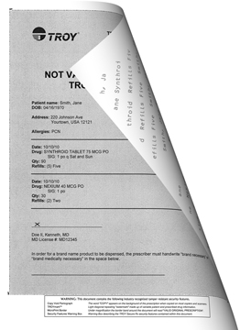
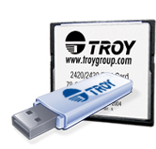
TROY GROUP Inc.
Rx upgrade kits

Slide 24
TROY – Rx / DX upgrade kits
Memory card to plug into the printer internal USB or Compact Flash slot
Compact flash : 4250/4350
USB thumb drive : 3005, 3015, 4014, 4015, 4515, MFP 4345, M60x
To use in association with TROY Secure Port Monitor software (TROY Port Monitor evolution)
Adding Anti-copy and anti-fraud security features to a document
Pantograph
TROYMark
MicroPrint border
Warning Box
To secure original document as medical prescriptions, contracts, etc…
Signature line
Encryption
TROY fonts (no MICR font included)

Slide 25
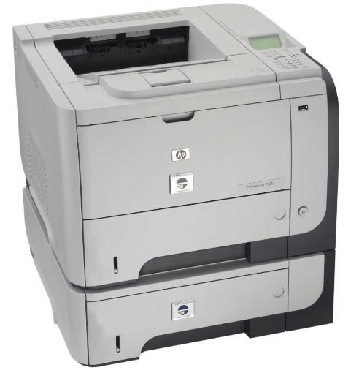
TROY GROUP Inc.
Secure Rx Printers
HP printer + TROY Rx functions embedded
LJ 3015, M60x

Slide 26
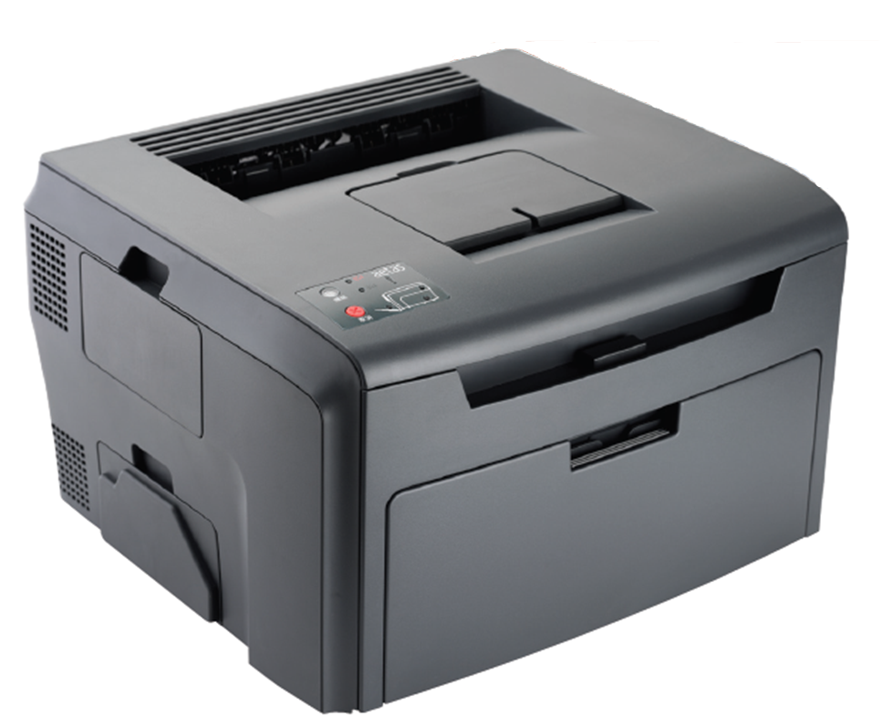
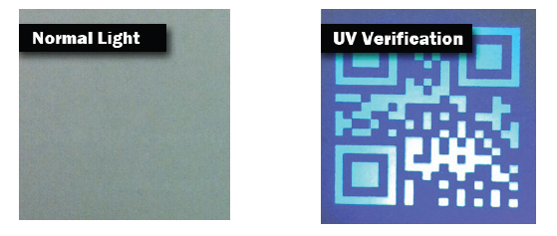
TROY SecureUV Printer.
TROY SecureUV Printer
Black and white and UV
Dedicated color will print UV
Technology LED, high resolution
Compact desktop size

Slide 27
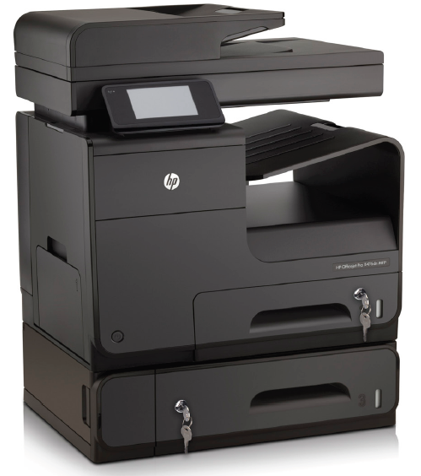
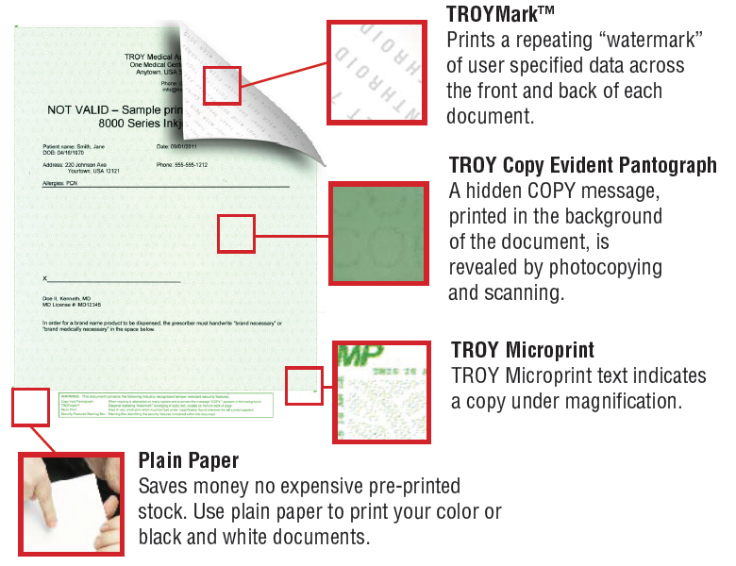
TROY SecurePro Jet
TROY SecurePro Jet
Inkjet color

Slide 28
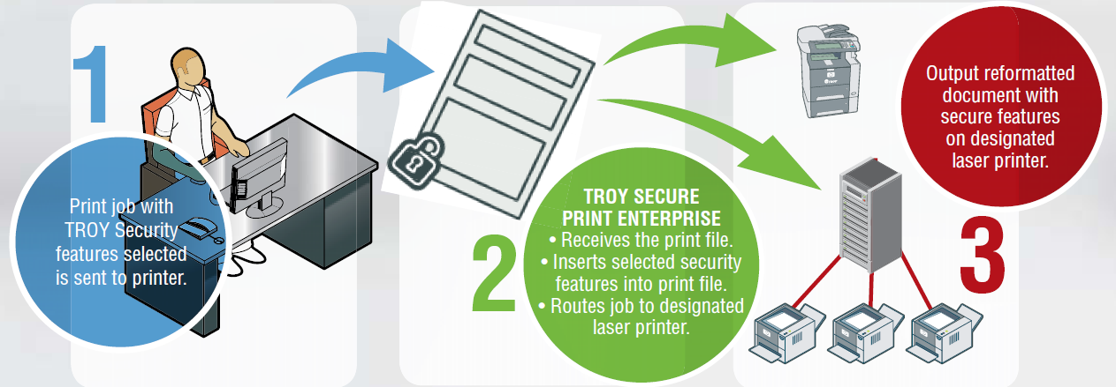
TROY - TSPE
TROY Secure Print Enterprise
Rx / DX security features integrated into a software
Software captures the job and add security features then route it to a printer.

Slide 29
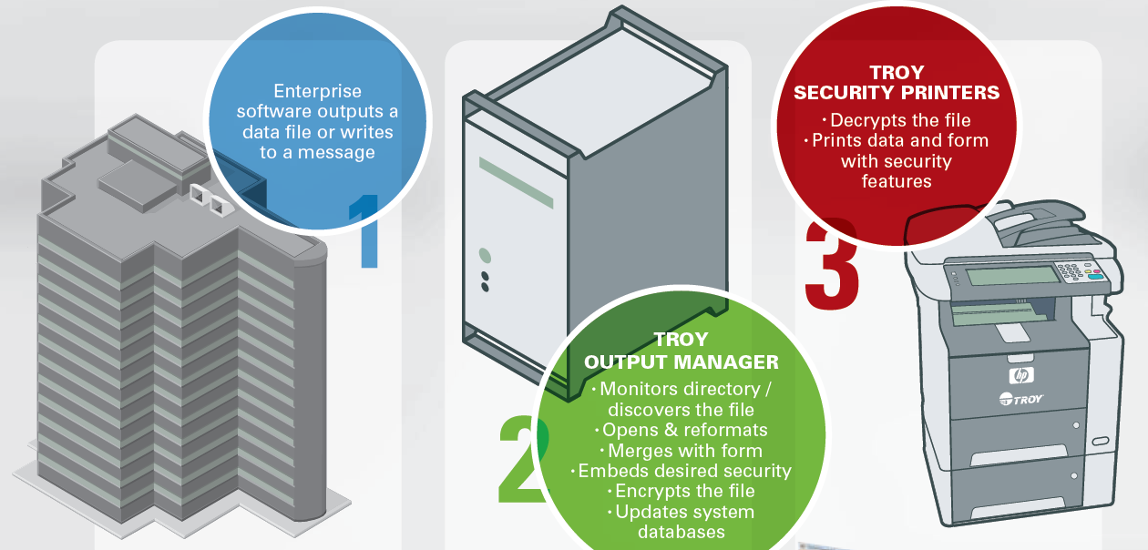
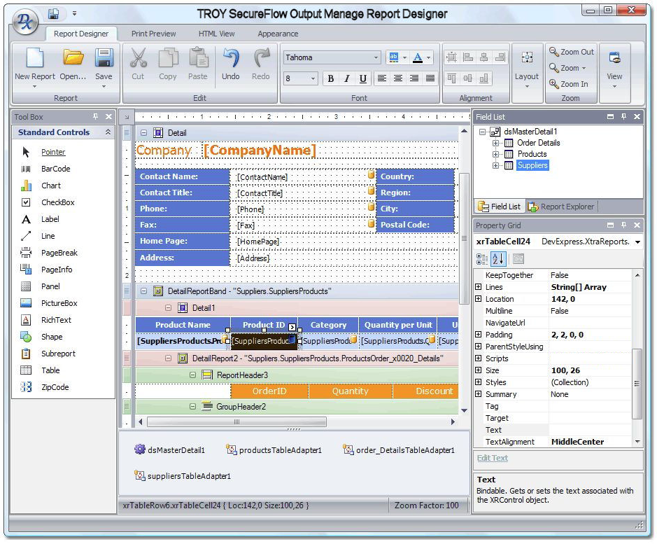
TROY - TSOM
TROY Secure Output Manager
Print engine
Raw data are copied into a folder
TSOM pick up the file
Parse the data
Merge the data with a template
Add the TROY security features
Send it to the printer fleet
When?
Customer has data to print into an elaborate template automatically.
No user interface needed, works in the background

Slide 30
TROY - TCWS
TROY CheckWriting Software
Check Printing Software
English only
Windows 7 only
User Interface
Signature cards
Manual checks
When?
Customer has data to print into an elaborate template.
Needs for user interface, user roles and permissions, approvals, logs

Slide 31
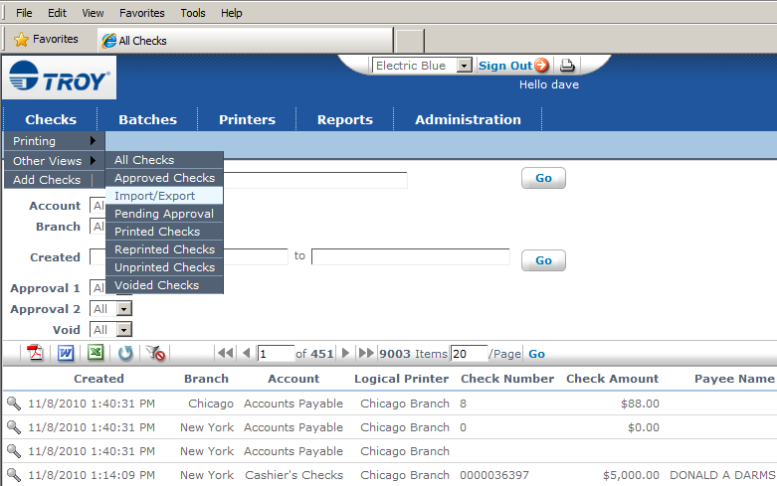
TROY - Secure CheckFlow
Secure CheckFlow
Check Printing Software
Web application
User Interface
Manual checks
When?
Big deals
Customer has data to print into an elaborate template.
Needs for user interface, user roles and permissions, approvals, logs

Slide 32
TROY - Check Printing
TROY CheckPrinting
Sage 50
Quickbooks
When?
Customer needs an add-on to Sage 50 or QuickBooks to print checks

